Slide 1

MicroArch Nomen Numen Greg Thain
Notes:
Today I want to teach all of you a superpower. This superpower, like most, may seem trivial on the surface, but requires practice, discipline, and attention to detail in order to hone. Also, it has a dual, a super-weakness that is a trap all too easy to fall into. The good news is this super power is almost universally available. My name is Greg Thain, I am an HTCondor developer, but this super-power can be used not just by developers, but also by users of the software, administrators and SREs, facilitators. It is so universally applicable that I believe it can even be used by management.
Today I will teach you generally about this superpower, and show a case study with microarchitecture in the OSPool,

Slide 2
OS Pool
Notes:
So let's being with The OSPool
Many people here have had a hand in building, operating, using, or supporting the OSPool.
So, I'd like everyone in this room to take a moment and visualize the OSPool in your head as you see it. As an image, a mind map, or a mental model, however you think of the OS pool today, in all its glory.

Slide 3
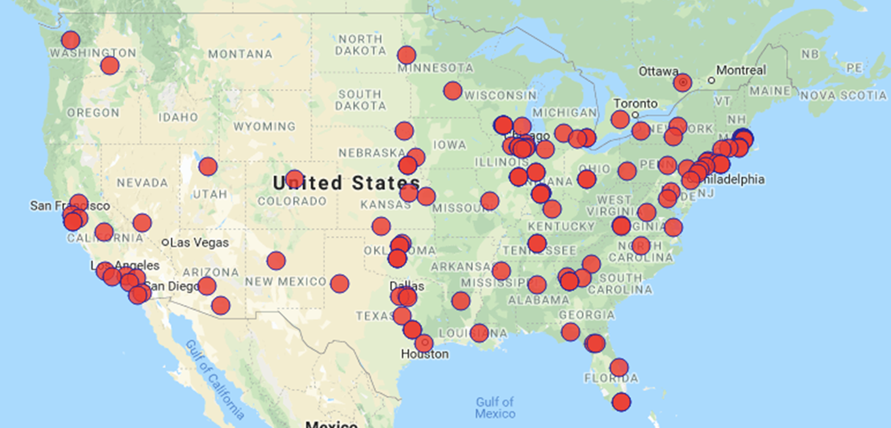
Notes:
Maybe some people, especially those in management, think about it like this – a community of sites, mostly across the us.

Slide 4
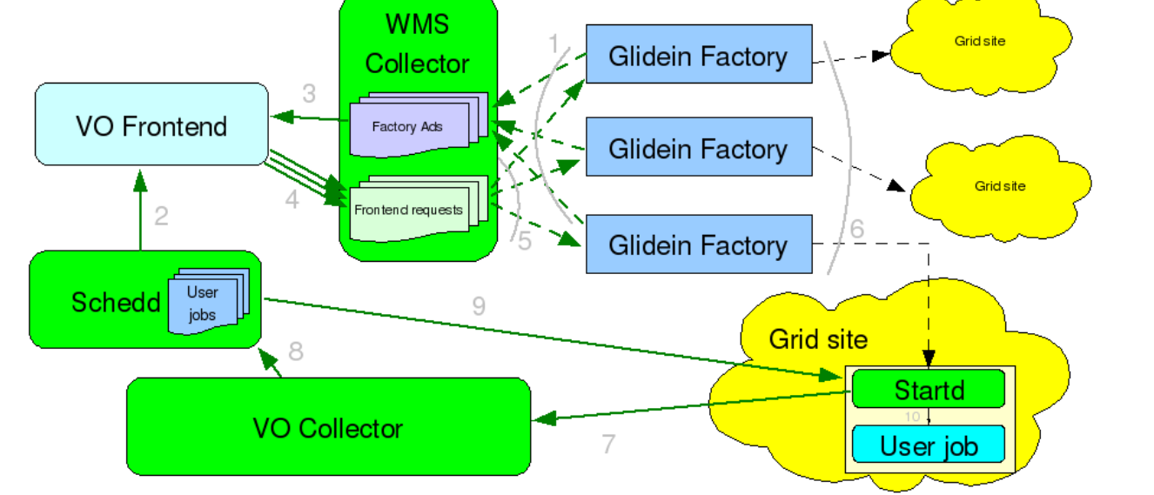
Notes:
Or maybe if you are the sort of person who dreams in Python, and has long hallway arguments about what "Pythonic" really is, you might think of it like this

Slide 5
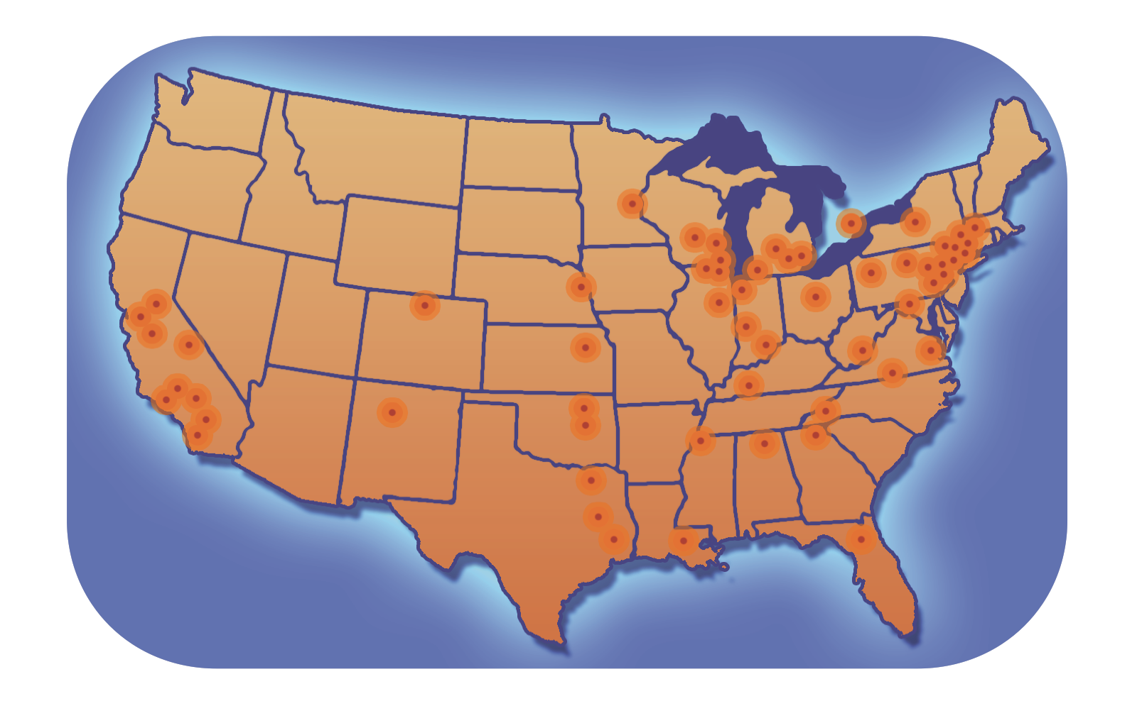

Open Science
Grid
Campus Clusters
Local
pool
Notes:
Or, if you work with researchers, maybe you think about the os pool like this.

Slide 6
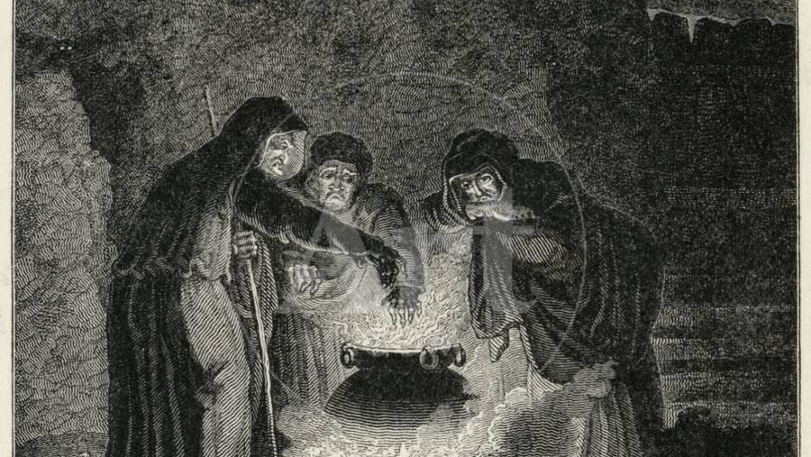
Notes:
But this is how I see the OSPool – a bubbling cauldron of chaos.
And lest you think that I am denigrating the OSPool, I would point this out – ask any physicist: without entropy there is no energy, (or perhaps an information scientist), and there sure is a lot of entropy in the OSPool. It is our job then, to tame this cauldron of entropy and put it to good use.
Which make those of use who use the OSPool like the witches in Shakespeare's Scottish play – bubble bubble toil and trouble – transfer sandboxes on the double.
But the patriarchy of dominant religion has put an unfortunate spin on this term, so let's call ourselves by the gender-neutral term "Sorcerers".

Slide 7
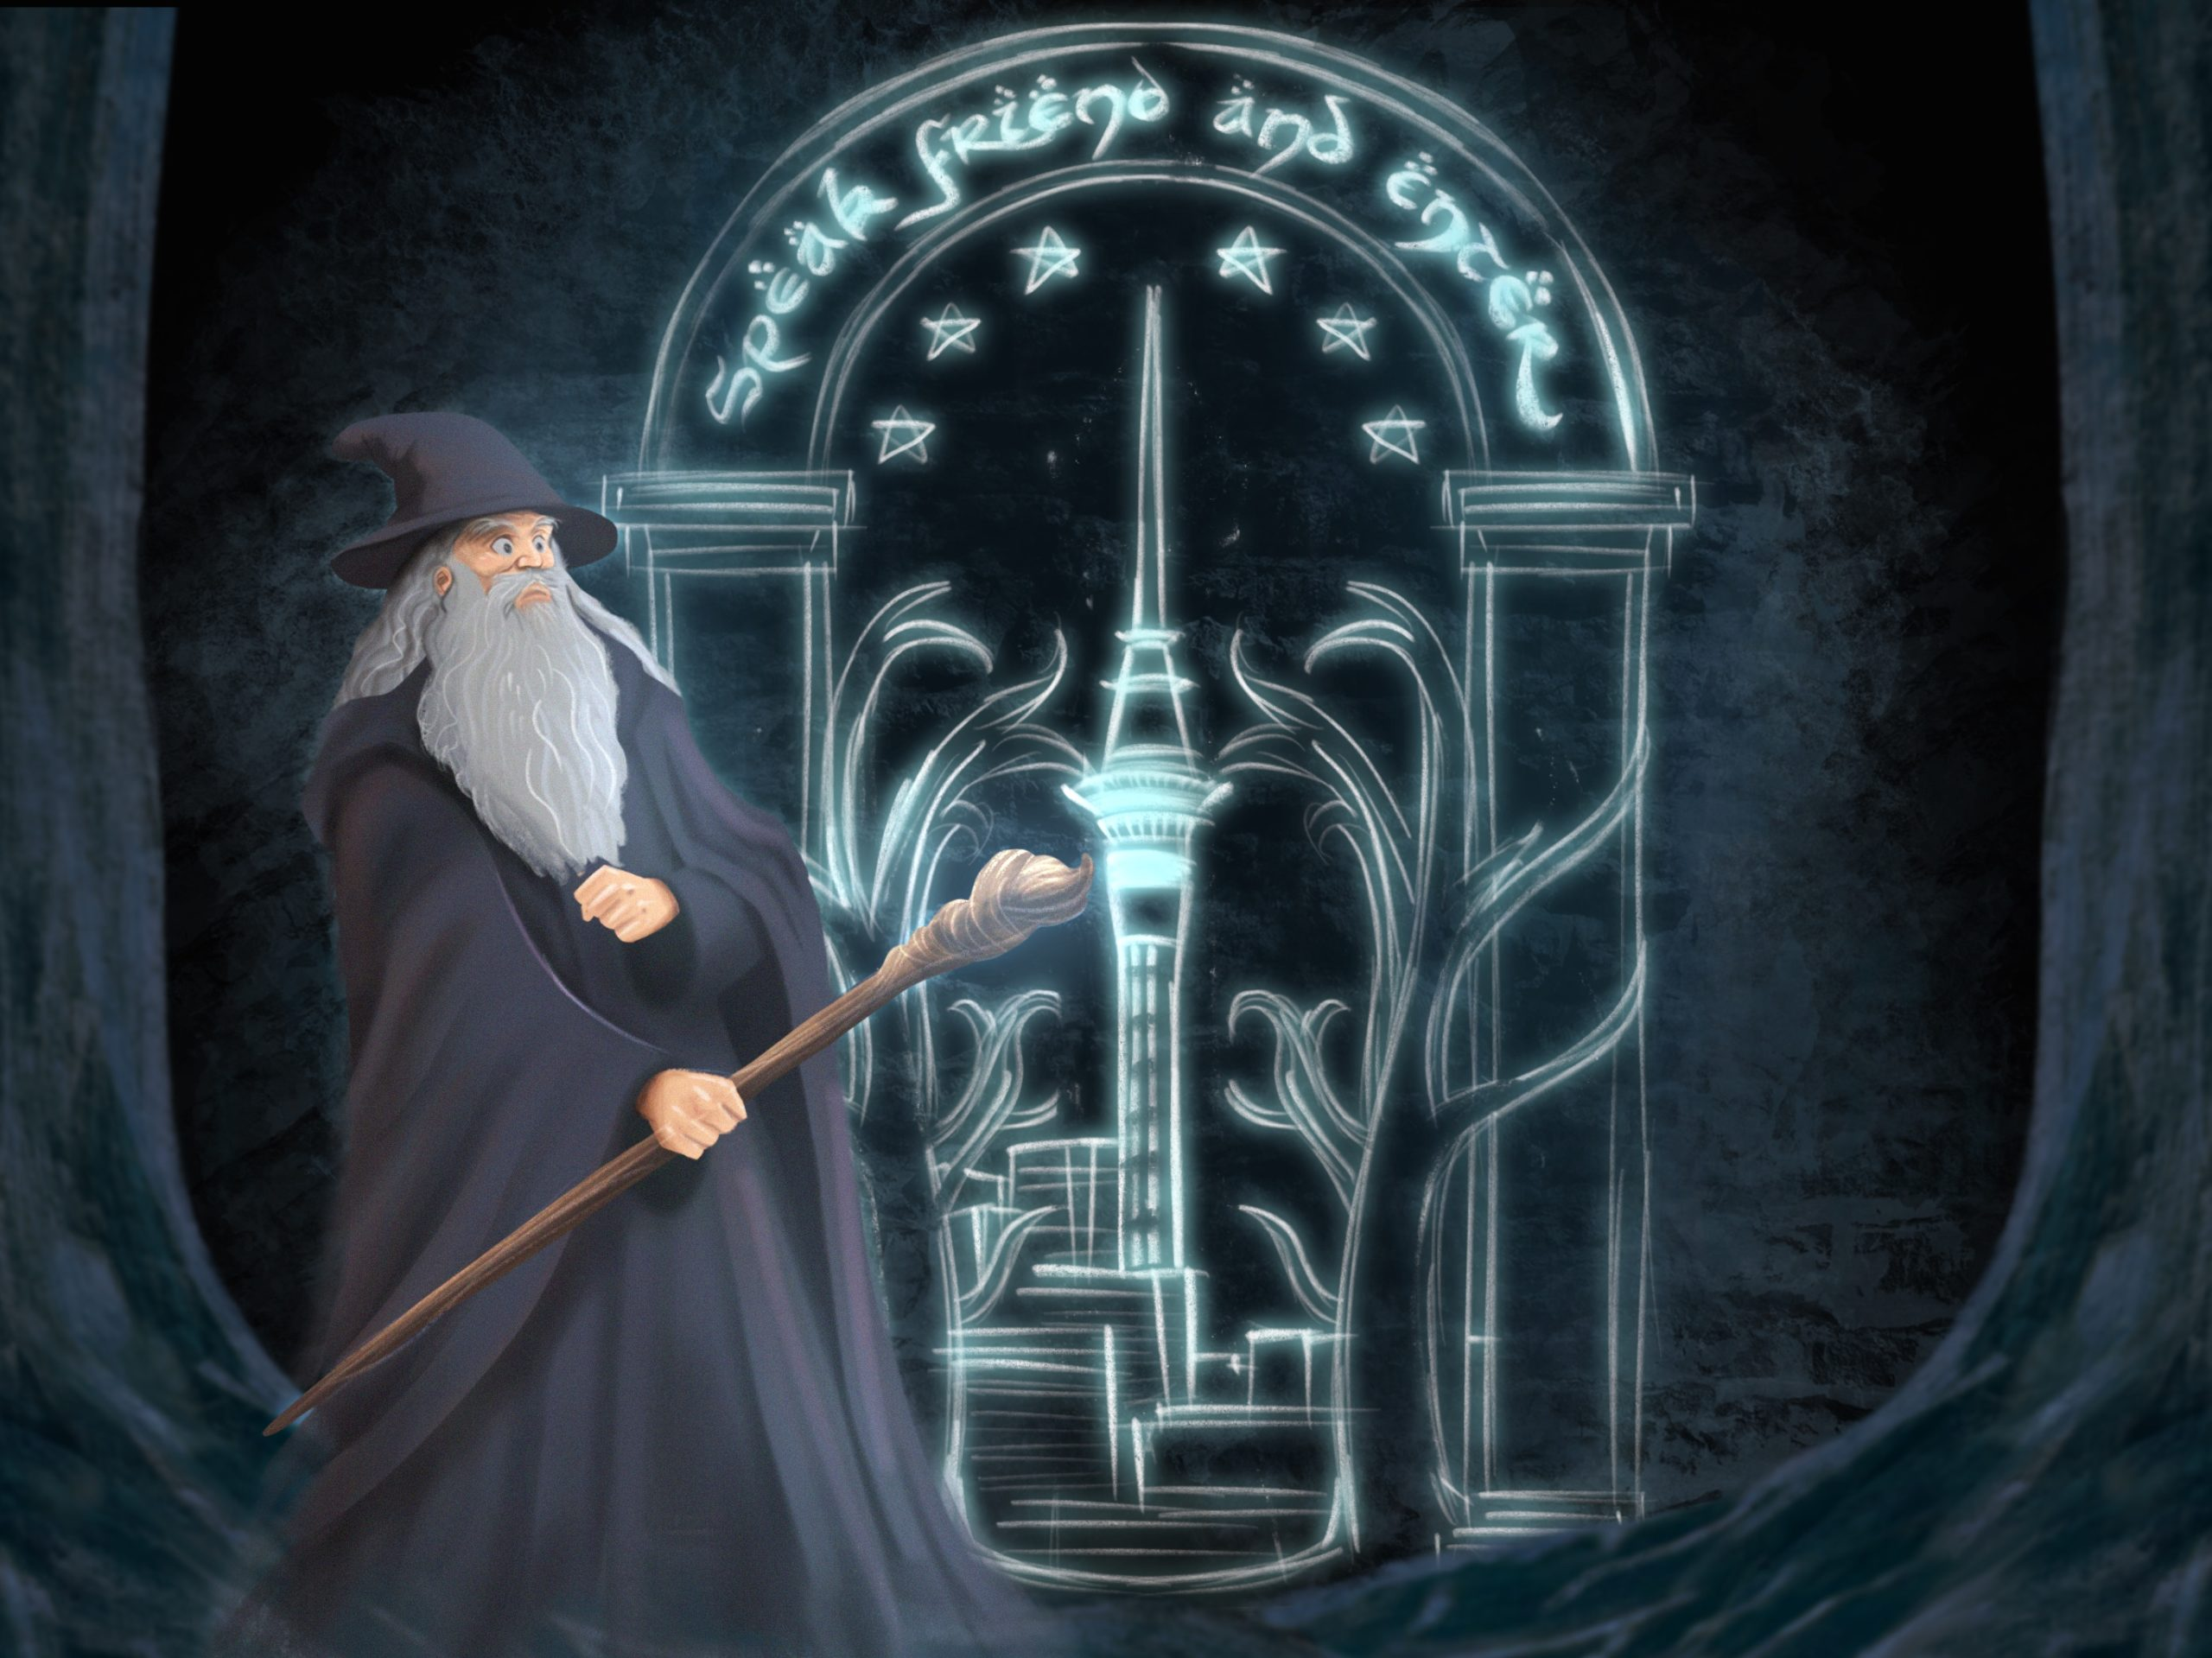
Notes:
And there is an ancient truth about sorcerers which is the theme of this talk:
Sorcerers only have power over an object when they can speak the true name of that object.
Unfortunately, like many of our deepest truths, this is not to be found in textbooks, computer science or otherwise, but it deeply woven into the DNA of our culture and literature.
"Speak, friend and enter"
NOTE – find female sorceror

Slide 8
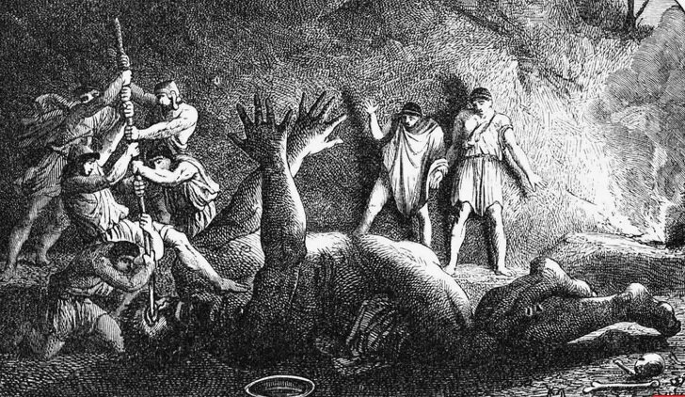
Notes:
Going all the way back to Homer, whose hero, the wily Odysseus refused to give his true name (and thus power) to his captor, the carnivorous cyclops Polyphemus, which ensured his escape.

Slide 9
The
beginning of
Wisdom
is to call things by their proper name.
-- Confucius
Notes:
And this idea is not exclusive to Western thought, either.

Slide 10


Slide 11

Notes:
Closer to home, both temporally and geographically, authors are still presenting this idea of the power of names.

Slide 12
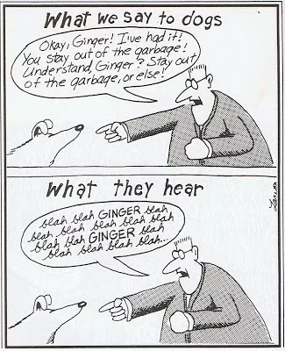
The Power of Clarity
Most of the jobs work, but some are failing in the job router, but those jobs that do work are running faster than we expected.
Blah blah blah JOBS blah blah blah JOBS blah blah blah JOBS
Notes:
I don't want you to think I'm being flippant, or hyperbolizing – I am serious here. Finding and using good names give you power. It is often hard to do, and we've joked in the past that we are bad at naming, because it is hard. But that doesn't mean that we should give up. Rather, we need to double down on our discipline to discover good names for our creations.
There are at least three concrete ways that a good name gives us power. The first way is the power of clarity.
Sometime today, someone in this conference will have a conversation with someone else where some problem about a job will be discussed. But there will be confusion, unneeded friction, and difficulty in communication because the term Job is so overloaded. Is this problem about a glidein, which we call a job, though it doesn’t really have the job nature? The science payload job? Is it the dagman-proper scheduler universe job, or a job router job, and if so, the a side, the b side or both in the job router? This is a large source of our problems.
This shows something else about good names – they are not absolute, but relative to some context. "job" is a great name in a generic context, but often we need more specfici names for more specific contexts.

Slide 13
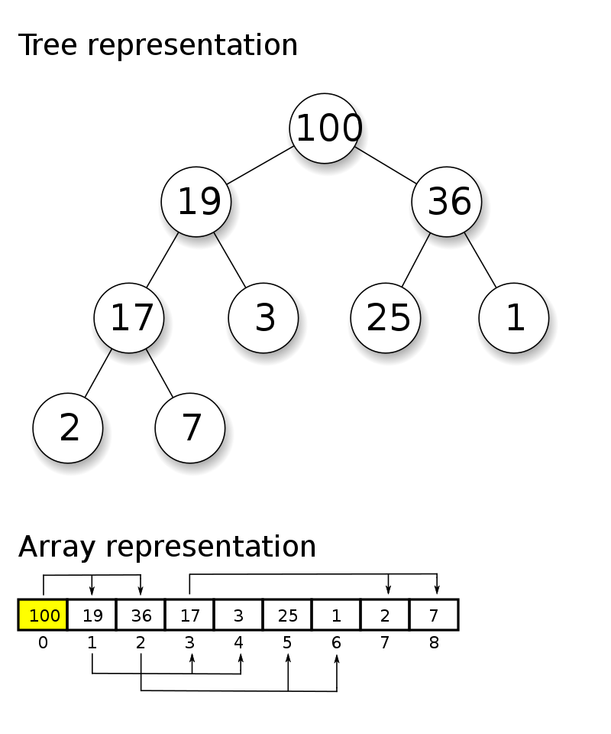
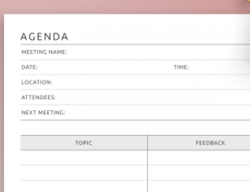
The Power of Metaphor
Heap
Notes:
The power of clarity, though useful, isn't nearly as powerful as the power of metaphor.
DAGman has long had the capability to give each node a priority. However, we recently hit a problem where if you use this feature with thousands of nodes, dagman grinds to a halt – it gets quadratically slower. The solution to this is well known in the cs community: the set of nodes with priorities is called a priority queue (a name that only a mathematician) could love, and we implement this data structure with an algorithm known as a "heap". This is an awful name, not just because every time you say "heap", you must clarify "the heap algorithm", "not the dynamically allocated memory heap" (which is usually implemented with a completely different algorithm). I honestly believe that one reason the heap algorithm isn't used as often as it could be is because of this unclear name. If you don't know what it is, the name doesn't help you understand what it is, or how it can help you. And that lack of clarity might be why dagman didn't use it.
I was recently re-reading one of the classic CS texts, "The Structure and Interpretation of Computer Programs", and I tripped over something I had never noticed before. This text describes a priority queue, but by a different name:
The Agenda. This is a much better name. Even if you have no idea what the operations on a "heap" are, I bet you can guess the operations on an "Agenda". And this illustrates the power of metaphor – with a good metaphorical name, one can easily guess the operations on an object with explicitly being taught them. A superpower indeed, when we can find these names.

Slide 14

The Power of Generation
By Asheiou - Own work, CC BY-SA 4.0, https://commons.wikimedia.org/w/index.php?curid=129116417
Notes:
The strongest power of a good name, is the power of generation. While the power of metaphor lets use compress the communication required, the power of generation let's us agree on how an object should be extended and enhanced in the future.
By Asheiou - Own work, CC BY-SA 4.0, https://commons.wikimedia.org/w/index.php?curid=129116417

Slide 15
The Best Time to Plant a Tree
Submit Point
Access Point (AP)
Compute Element (CE)
Compute Entryway (CE)
Notes:
There's an old saying that the best time to plant a tree is 20 years ago, and the second-best time is today. So too, is it for choosing good names. As it is hard, we frequently get it wrong. Recently, we've been working at replacing names, like renaming the submit point (which is not necessarily where submit runs) with Access Point, or AP, and renaming the Compute Element (the place where compute DOESN'T happen with compute entryway. These name changes can be tough, but they are worthwhile for a project we expect to be going for years. But better to spend the time to get new names right in the first place.

Slide 16




<
<
<
10th Gen
10th Gen
10th Gen
10th Gen
<
<
<
11th Gen
11th Gen
11th Gen
11th Gen
Notes:
So, with all that high level talk out of the way, let's bring this down to HTCondor and the OS pool. The OSPool mainly runs on x86 processors, made by Intel and AMD. Because we want not cycle to go unused, a prime principle of the OSPool is to very lenient in the kinds of computers we accept in the pool. This is a big difference from HPC centers, which are very homogenous, often with only 1 or 2 different kinds of computers in each cluster.
The Intel processors are named "i3", "i5", "i7" and "i9" (mostly) where the larger numbers are faster. But, that's only true within one generation…

Slide 17
10th Gen
10th Gen
11th Gen
10th Gen
11th Gen
10th Gen
11th Gen
11th Gen
Notes:
For a strict ordering of speed across generations, there is no easy way to get a strict ordering. One generation's i5 might be slower than the next generation's i3. This is important for the OSPool, as we may want to grant more wallclock time to jobs running on slower processors, or only start long running jobs on faster processor. But the real problem is much worse than that.

Slide 18
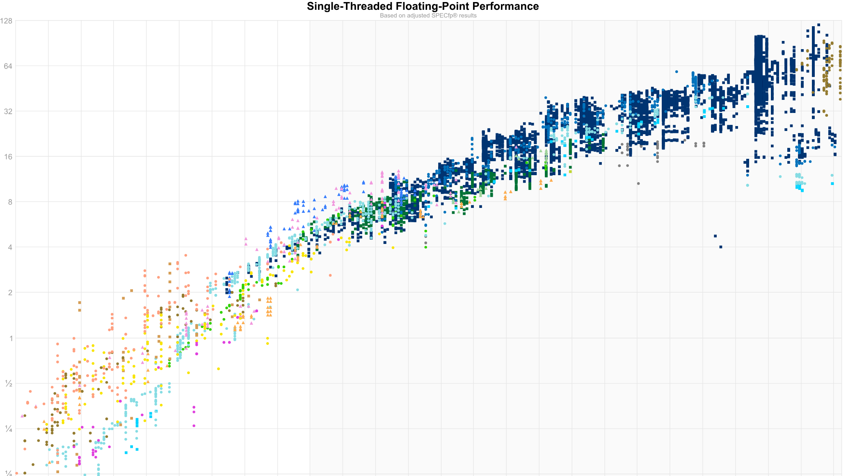
Notes:
The real problem is that we have run out of "free speed" merely by increasing the clock speed. To make processors faster, CPU architects have been adding more cores to the chip, more caches, and more to the point, more instructions in their newer processors that don't exist in previous ones.
https://github.com/HenkPoley/analyze-spec-benchmarks/blob/37f3c74d0422bae21a71fca892be5bd27998467b/fp_graph.svg

Slide 19
Year | Insn | Family | Description
2001 | SSE2 | P6 | Attempt to replace the original MMX instructions; wider XMM registers offer better performance
2004 | SSE3 | Core | Streaming SIMD Extensions 3; new instructions to operate on multiple values in the same register
2006 | SSSE3 | Core | Supplemental Streaming SIMD Extensions 3; additional instructions for working with packed integers
2007 | SSE4.1 | Penryn | Streaming SIMD Extensions 4.1; initial set of instructions for manipulating media data
2007 | SSE4a | K10 | 4 SIMD instructions, not related to 4.1/4.2
2007 | ABM | K10 | Advanced Bit Manipulation; bit counting instructions
2008 | SSE4.2 | Nehalem | Streaming SIMD Extensions 4.2; second set of instructions for manipulating media data
2007 | SSE5 |  | Proposed by AMD in 2007 but was never implemented
2008 | SSE4 |  | Streaming SIMD Extensions 4; Another name for SSE4.1 + SSE4.2
2010 | CLMUL | Westmere | Carry-less multiplication of two registers
2011 | AVX | Sandy Bridge | Advanced Vector Extensions; introduces 256-bits integer operations
2012 | F16C | Ivy Bridge | Extension for performing half-precision <-> single-precision conversions
2011 | XOP | Bulldozer | eXtended Operations; various vector operations
2011 | FMA4 | Bulldozer | 4-operands fused multiply-add
2011 | LWP | Bulldozer | Lightweight Profiling
2011 | SMX | Nehalem | Safer Mode Extensions; instructions needed to facilitate trust decisions (Part of Intel's Trusted Execution Technology)
2011 | AES | Westmere | Instructions for optimizing AES operations
2012 | TBM | Piledriver | Trailing Bit Manipulation; bit manipulation instructions designed to be compiler intrinsics
2013 | BMI1 | Jaguar | Bit Manipulation Instruction Set 1; introduces a number of bit manipulation instructions
2013 | BMI2 | Haswell | Bit Manipulation Instruction Set 2; introduces additional bit manipulation instructions
2013 | FMA3 | Haswell | 3-operands fused multiply-add
2013 | TSX | Haswell | Transactional Synchronization Extensions; adds transactional memory support
2013 | AVX2 | Haswell | Advanced Vector Extensions; additional instructions
2014 | ADX | Broadwell | Multi-Precision Add-Carry Instruction extension
2014 | RdRand | Broadwell | Part of Secure Key Technology extension (RdRand, RDSEED)
2014 | PREFETCH | Broadwell | PREFETCH instructions (previously part of 3DNow!)
2015 | AVX-512 | Airmont | 512 bit register operations
2015 | MPX | Skylake | Memory Protection Extensions
2015 | SGX | Skylake | Software Guard Extensions
2016 | SHA | Goldmont | SHA Extensions
2017 | SME | Zen | Secure Memory Extensions
2019 | TME | Ice Lake | Total Memory Encryption
Notes:
There's a statistic I'd love to quote here that I heard in a UW presentation that I just can't find. It goes something like the average rate of added new instructions in an x86 chip over the last 20 years is 3 new instructions a week – if anyone knows the source, I'd love to have it.
Here's a very partial table of these instructions, the year they were added and the Intel codename that got the instructions. Note that this codename has nothing to do with the marketing name of the cpu
https://en.wikichip.org/wiki/x86/extensions

Slide 20
Year | Insn | Family | Description
2001 | SSE2 | P6 | Attempt to replace the original MMX instructions; wider XMM registers offer better performance
2004 | SSE3 | Core | Streaming SIMD Extensions 3; new instructions to operate on multiple values in the same register
2006 | SSSE3 | Core | Supplemental Streaming SIMD Extensions 3; additional instructions for working with packed integers
2007 | SSE4.1 | Penryn | Streaming SIMD Extensions 4.1; initial set of instructions for manipulating media data
2007 | SSE4a | K10 | 4 SIMD instructions, not related to 4.1/4.2
2007 | ABM | K10 | Advanced Bit Manipulation; bit counting instructions
2008 | SSE4.2 | Nehalem | Streaming SIMD Extensions 4.2; second set of instructions for manipulating media data
2007 | SSE5 |  | Proposed by AMD in 2007 but was never implemented
2008 | SSE4 |  | Streaming SIMD Extensions 4; Another name for SSE4.1 + SSE4.2
2010 | CLMUL | Westmere | Carry-less multiplication of two registers
2011 | AVX | Sandy Bridge | Advanced Vector Extensions; introduces 256-bits integer operations
2012 | F16C | Ivy Bridge | Extension for performing half-precision <-> single-precision conversions
2011 | XOP | Bulldozer | eXtended Operations; various vector operations
2011 | FMA4 | Bulldozer | 4-operands fused multiply-add
2011 | LWP | Bulldozer | Lightweight Profiling
2011 | SMX | Nehalem | Safer Mode Extensions; instructions needed to facilitate trust decisions (Part of Intel's Trusted Execution Technology)
2011 | AES | Westmere | Instructions for optimizing AES operations
2012 | TBM | Piledriver | Trailing Bit Manipulation; bit manipulation instructions designed to be compiler intrinsics
2013 | BMI1 | Jaguar | Bit Manipulation Instruction Set 1; introduces a number of bit manipulation instructions
2013 | BMI2 | Haswell | Bit Manipulation Instruction Set 2; introduces additional bit manipulation instructions
2013 | FMA3 | Haswell | 3-operands fused multiply-add
2013 | TSX | Haswell | Transactional Synchronization Extensions; adds transactional memory support
2013 | AVX2 | Haswell | Advanced Vector Extensions; additional instructions
2014 | ADX | Broadwell | Multi-Precision Add-Carry Instruction extension
2014 | RdRand | Broadwell | Part of Secure Key Technology extension (RdRand, RDSEED)
2014 | PREFETCH | Broadwell | PREFETCH instructions (previously part of 3DNow!)
2015 | AVX-512 | Airmont | 512 bit register operations
2015 | MPX | Skylake | Memory Protection Extensions
2015 | SGX | Skylake | Software Guard Extensions
2016 | SHA | Goldmont | SHA Extensions
2017 | SME | Zen | Secure Memory Extensions
2019 | TME | Ice Lake | Total Memory Encryption
Notes:
And it goes on and on and on. What does this mean for the OSPool?
https://en.wikichip.org/wiki/x86/extensions

Slide 21
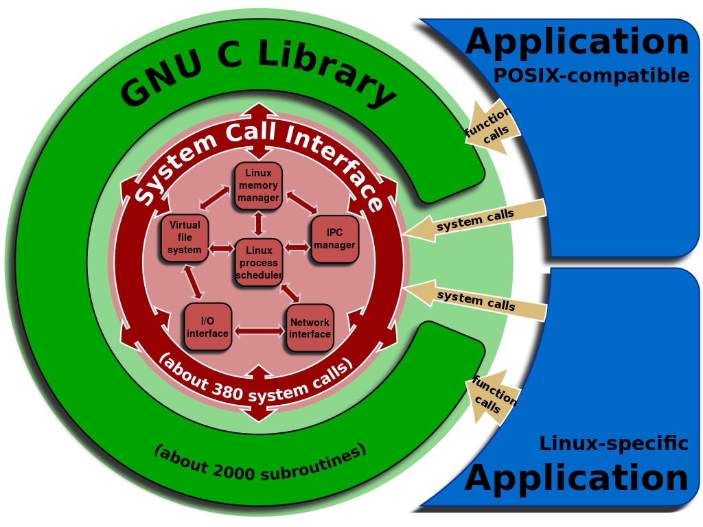
The hard way…
X86-64-v1
?
X86-64-v2
X86-64-v3
OpenSSL
Cryptography and SSL/TLS Toolkit
X86-64-v4

Slide 22
Cores in OSPool by codename
Notes:
Here's a table of the number of cores in the Ospool last week, broken down by Intel and AMD codename, and thus by the set of instructions available to programs that run on them.
I would say this chart has a lot of data, but not much information. What decisions can we draw from this chart? I'm not sure.
And looping back up to the high level of this talk, the reason this chart isn't very useful is because we are using a poor name, for our chips. The name is too specific, it isn't clear, it doesn't have any metaphoric or generative extensions. Can anyone remember if a Cascade Lake cpu is faster or slower than a Castle peak? I don't.

Slide 23
Why is this a problem?
If (CPU job built for) > CPU → Crash with SIGILL
if (CPU job built for) < CPU
→ Run slower than possible
Notes:
This is a problem for two reasons. Both stem from running jobs which have been compiled for a cpu instruction set that doesn't match the one it will run on in a HTCondor pool. Obviously, in a hetereogenous pool, this is a big headache. The biggest problem is the first one, when we try to run a job built for a CPU and using machine instructions that don't exist on the EP it lands on. The job will eventually crash when it hits the first unimplemented instruction with the cryptic SIGILL signal. Worse, it won't tell you what instruction failed, or what kind of machine it really needs. In many pools, the jobs users run are compiled by someone else, so the submitting user doesn't even know how the job was built.
The other way round isn't nearly so dramatic. The job will run correctly to completion but may run slower than possible. How much slower? Impossible to say in general, but good use of the SIMD vector instructions on some newer processors can give a several fold speedup for certain codes.
AND, the OSPool alone has dozens of different CPUs!

Slide 24
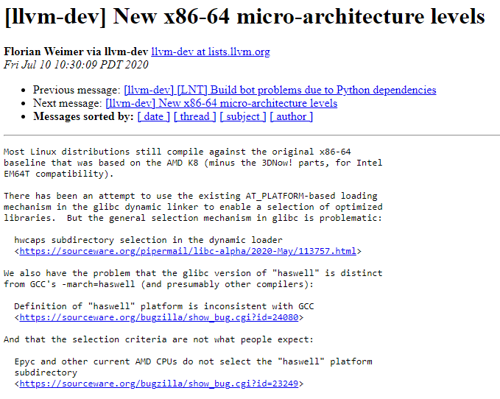
Intel + RedHat to the rescue!
Notes:
In July of 2020, Florian Weimar of Red Hat proposed a solution to this problem, for it is a problem that red hat has as well. They surely don't want to build, release and support dozens of cpu-specific builds of all of their products. In the past, they've always built for the very least common denominator, and they were suffering from the #2 problem we talked about earlier. But they didn't have a good vocabulary or name to fix the problem, so they invented one – a microarchitecture level with a limited set of values, each one covering roughly 5 years of cpu developments. After this proposal, Intel, AMD, compiler vendors and others quickly came on-board: witness the superpower of a good name.

Slide 25
Microarch: four levels
Haswell
Broadwell Skylake Cascade Lake
…
Core
Core 2
Penryn Wolfdale
…
Saphire Rapids
Rapids Lake
Granite Rapids
Willow Cove
…
Nehalem
Westmere
Sandy Bridge
Ivy Bridge
…

Slide 26
Microarch: four levels
Core
Core 2
Penryn Wolfdale
…
Nehalem
Westmere
Sandy Bridge
Ivy Bridge
…
Haswell
Broadwell Skylake Cascade Lake
…
Saphire Rapids
Rapids Lake
Granite Rapids
Willow Cove
…
x86_64-v1
x86_64-v2
x86_64-v3
x86_64-v4

Slide 27
Microarch: strict hierarchy
V4
V3
V2
V1

Slide 28
Compilers and microarch
$ gcc –march=x86-64-v3 source.cpp
$ file a.out
a.out: ELF 64-bit LSB shared object, x86-64, version 1 (SYSV), dynamically linked, interpreter /lib64/ld-linux-x86-64.so.2, for GNU/Linux 3.2.0

Slide 29
HTCSS Support for microarch
$ condor_status -af Name MicroArch
slot3@build4000.chtc.wisc.edu x86_64-v3
slot1@e2007.chtc.wisc.edu x86_64-v4
slot1@e2008.chtc.wisc.edu x86_64-v4
slot1@e3001.chtc.wisc.edu x86_64-v1

Slide 30
HTCSS Support for microarch
$ condor_status –const \ 'microarch > "x86_64-v2" '
slot3@build4000.chtc.wisc.edu x86_64-v3
slot1@e2007.chtc.wisc.edu x86_64-v4
slot1@e2008.chtc.wisc.edu x86_64-v4

Slide 31
HTCSS Support for microarch
Executable = calculate.exe
Requirements = microarch > "x86_64-v2"
Request_memory = 1Gb
Request_disk = 100Mb
Request_cpus = 2
queue

Slide 33
More uArch problems
AES acceleration in HTCondor v10.0
Encryption FREE for "modern CPUs"…

Slide 34
Future Wishlist
Automatic detection of microarch in binaries
Microarch specific packaging?

Slide 35
Recap
Names have power
MicroArch
Learn it
Use it
Teach it
Invest in good naming

